Slide 1
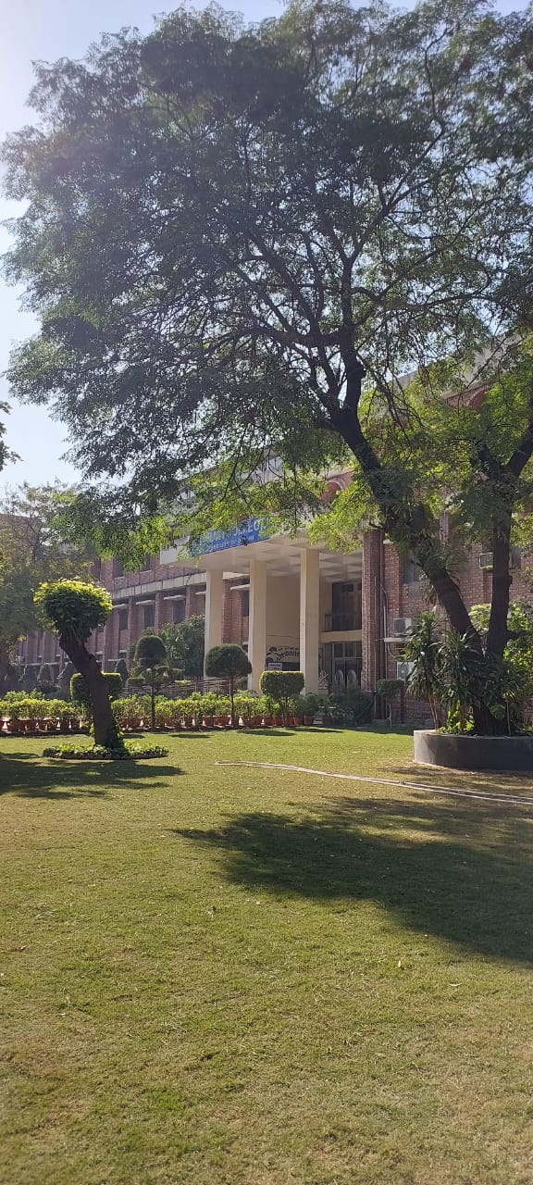
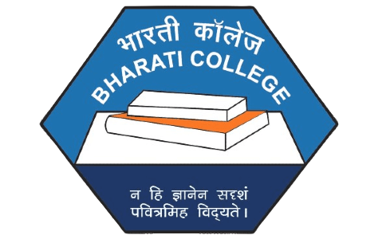

Bharati College
University of Delhi
Department of Political Science
AUDIT REPORT
2023-24/ 2024-25

Slide 2
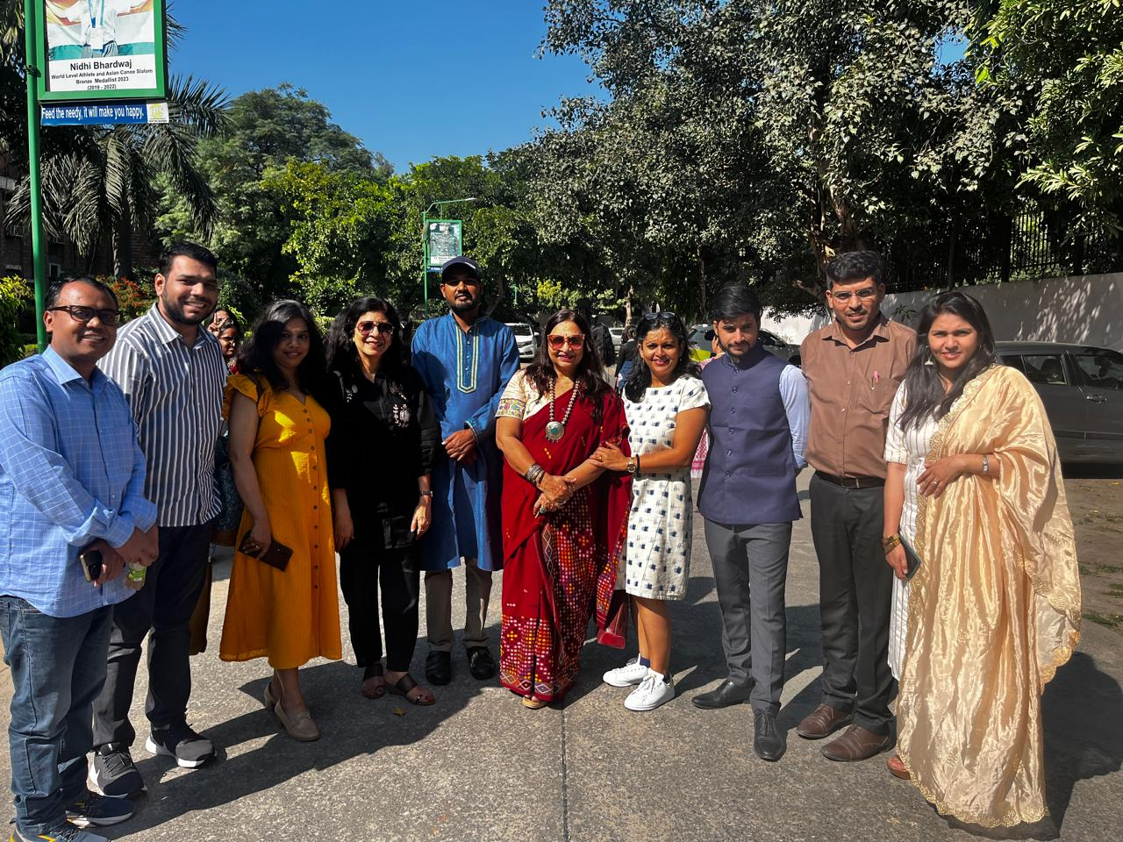
About the Department
The Political Science Department is one of the oldest department of Bharati College, University of Delhi. Presently, the department offers three-year bachelor’s degree courses, in which we have two sections of honours with a maximum strength of 40 in each section. Also, two sections of Major and Minor courses is being offered to the BA Programme students.
We also offer Discipline Specific Elective, General Elective, Skill Enhancement, and Value-Added papers for all the students BA Hons., & BA Programme.

Slide 3

Vision of the Department
Academic Focus: The department fosters a dynamic learning environment emphasizing critical thinking and deep understanding of political systems, governance, and public affairs.
Skill Development: It aims to equip students with strong analytical, research, and communication skills, along with a commitment to democratic principles.
Global and Ethical Outlook: The department encourages a global perspective and instills ethical reasoning and values among students.
Alignment with NEP 2020: The vision aligns with the National Education Policy's emphasis on multidisciplinary learning, holistic development, and ethical education.
Experiential and Civic Learning: The department promotes experiential learning methods and encourages active civic participation among students.

Slide 4

Departmental Societies
LOKSAMVAD | VIMARSH
About the Society – LokSamvad is the Political Science Society of Bharati College, a constituent college of the University of Delhi. Its primary aim is to disseminate political knowledge among students through creative and participatory methods. The society serves as an interactive platform, engaging students in various academic and co-curricular activities. | About the Society - VIMRASH: The academic society of the Political Science department aims to facilitate the students with a holistic peer learning environment. This society primarily engages in academic activities like organising lectures, Talks, discussions, Book Discussions, research insight sessions, and promotes civic sense and democratic ethos.

Slide 5
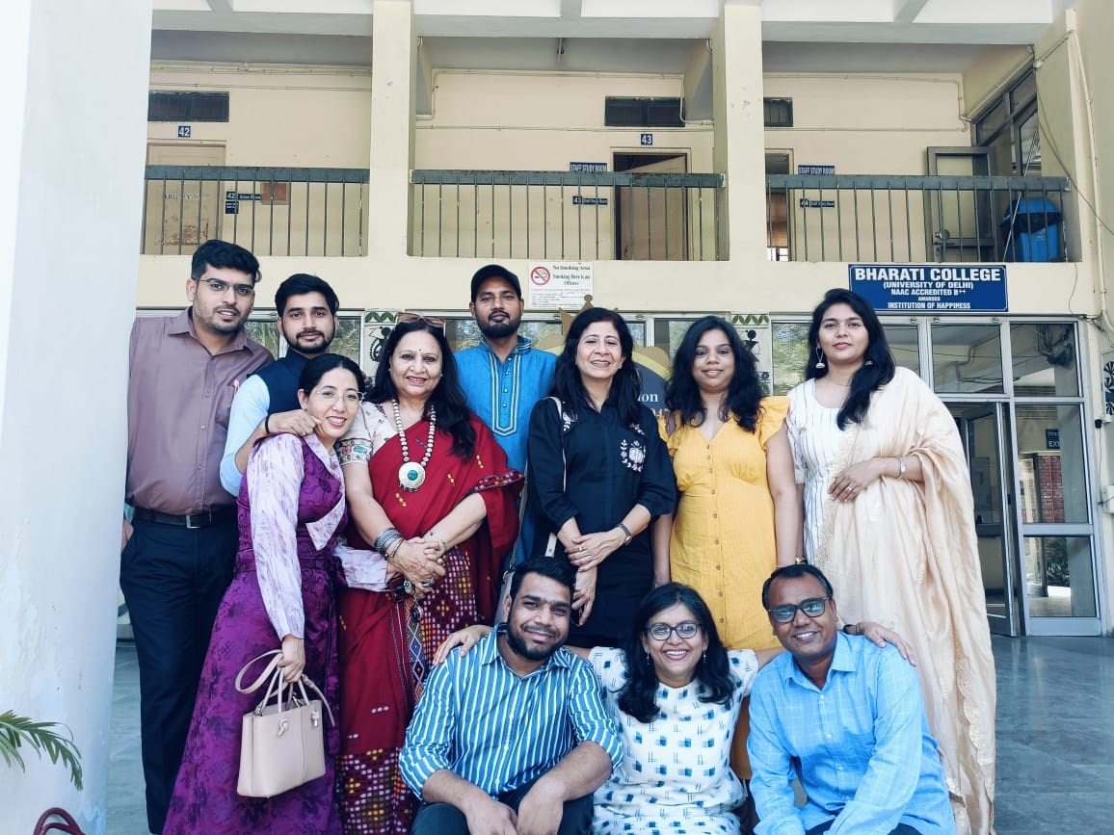
Faculties of the Department
Prof. Sangit Sarita Dwivedi
Professor
orcid.org/0000-0002-7470-3820
Dr. Anuranjita Wadhwa
Associate Professor
0000-0002-5261-2274
Dr. Bindu Kohli
Associate Professor
0009-0007-8834-7189
Dr. Deepti Singh
Associate Professor
0009-0003-8304-2109
Dr. Jaya Keral
Associate Professor
(On leave)
Dr. Shailza Singh
Associate Professor
0000-0002-9878-1508
Dr. Indu Baghel
Associate Professor
0009-0000-9803-4951
Dr. Vibha Maurya
Associate Professor
0009-0003-6881-1395
Ms. Sadhna Gupta
Assistant Professor
(On leave)
Ms. Ankita Singh
Assistant Professor
0009-0008-0786-2777
Dr. Anuradha Singh
Assistant Professor
0009-0007-3603-9571
Ms. Looke
Assistant Professor
0000-0003-4136-5893
Mr. Ajit Kumar
Assistant Professor
0009-0003-4817-0148
Dr. Indra Narayan Raman
Assistant Professor
0009-0002-2259-6549
Mr. Jatin
Assistant Professor
0000-0002-9253-9972
Ms. Stanzin Chuskit
Assistant Professor
0009-0000-3130
Mr. Vimlok Tiwari
Assistant Professor
0009-0001-6084-6310
Mr. Akshat Pushpam
Assistant Professor
0000-0003-3819-6195

Slide 6
Faculty Details
Faculty Strength
Professor – 1
Associate Professor – 7
Assistant Professor - 10

Slide 8
Departmental Research Profile
Publication in | No. of Publication in 2023-24/2024-25
Scopus | 5
UGC Care | 6
Peer Review | 4
Book Chapter | 7
Book Review Book Published | 6 2
Other | 0
H-Index
1

Slide 9
Individual Faculty Research
Dr. Anuranjita Wadhwa
’Theoretical Perspectives of the causation of domesticviolence’’International Journal of Political Science and Governance,2023; 5(2); ‘’From silent votersto ensuring womens’ representation’’Inclusive,Vol II, No. 24,2023-2024
International Journal of Social Science and Humanities, Volume 5, Issue 4, 2023
‘’Bridging digital gender divide’ The Indian Journal of Political Science, Vol LXXXV, No. 4, Oct-Dec 2024
Prof. Sangit Sarita Dwivedi
Sangit Sarita Dwivedi, Hindrance or Shield: Rediscovering India's Northeast, Indian Journal of Society and Politics, Volume 12, Number 01, February 2025.
“A Kaleidoscopic View of Gender Issues in South Asia: Nepal, Sri Lanka, Bangladesh”, Journal of South Asian and Middle Eastern Studies, (Villanova University), Volume 47, No. 2, Winter 2024.
“G 20 and India: India’s Quest with 20 Nations towards Development”, World Focus, May 2023, Delhi, (ISSN 2230-8458).
“Globalization and Human Migration”, Globalization: Contours & Trends (ed.) Dr. Vijay Kr. Verma & Dr. Anna Nath Ganguly, Pinnacle Learning, 2024.
Book Review on ‘The Trillion Dollar War: The U.S. Effort to Rebuild Afghanistan, 1999–2021’, by Abid Amiri, Journal of Advanced Military Studies, JAMS, Vol. 14, No.2, 2023, Published by Marine Corps University Press.
Dr. Shailza Singh
https://pacificaffairs.ubc.ca/book-reviews/india-in-the-indo-pacific-understanding-indias-security-orientation-towards-southeast-and-east-asia-by-aditi-malhotra/
One Singh, S., Varghese, P., Balaiah, S., & Sebastian, S. (Eds.). (2024). India and Southeast Asia in a Changing World: Exploring Relationship Prospects for a Sustainable Future (1st ed.). Routledge India. https://doi.org/10.4324/9781003570745 One -
Singh, S. (2023) ‘Globalisation and Global Social Movements’ in Understanding Globalisation by Nirmal Jindal and Kamal Kumar(Eds.) https://www.taylorfrancis.com/chapters/edit/10.4324/9781003434504-9/globalisation-global-social-movements-shailza-singh
Dr. Deepti Singh
“India’s G 20 and SCO Presidency: Resurgent India- Central Asia Relations”, Third Concept, Vol.38, No, 445, March 2024 (UGC Care listed with ISSN 0970-7247) ,
Influence of Traditional Sources on Bharat’s World View: From Panchsheel to Vashudhaiv Kutumbkam”, Madhya Bharati, July-December 2023, Vol. 85, UGC Care listed with ISSN 0974-0066, (Co-Author).
Dr. Indu Baghel
G20 and Sikhar Sammelan. International Journal of Social Sciences and Humanities, 5(4),2023.
Global Hegemony and Inclusive Democracy: India’s role in shaping G20 and P20 summit, International Journal of Sociology and Political Science.

Slide 10
Individual Faculty Research
Ms. Looke Kumari
A research article "साइबर सुरक्षा एवं भारत सरकार की नीतियों का अध्ययनः अवसर एवं चुनौतियां" in UGC Care list Journal Lokprashasan DOI: https://doi.org/10.32381/LP.2024.16.03.11
Looke Kumari (2024), "Covid 19 ka Sankat Aur Khadya Suraksha Neeti mein Nvachar: Pradhan Mantri Garib Kalyan Ann Yojana", Gyan Garima Sindhu, Commission for Scientific and Technical Terminology, Ministry of Education, Govt. of India, Vol.83-84, pp.37-44.
Looke Kumari (2024), "Vailalpik Vivad Niptan Vyavastha", Lok Prashashan, Indian Institute of Public Administration, Vol 16(1), pp 45-61.
Mr. Akshat Pushpam
A research article "भारत में गोपनीयता की अवधारणा का विकास : साइबर युग के विशेष सन्दर्भ में" in UGC Care list Journal Lokprashasan DOI: https://doi.org/10.32381/LP.2024.16.03.11
A paper entitled “Nature and Trends of Crime Against Dalits: A Study of NCRB Report” was published in the Scopus-indexed journal Economic and Political Weekly. https://www.epw.in/journal/2024/40/special-articles/natureand-trends-crime-against-dalits.html
Jatin, & Pushpam, A. (2025). Reservation Policy in India: State, Social Justice, and Affirmative Action: Narender Kumar & Sudhir Kumar Suthar. Orient Black Swan, Hyderabad, 2024. pp 144. Pb. ₹680. ISBN: 978-93-5442645-2. Asian Affairs, 1–3. https://doi.org/10.1080/03068374.2025.2464147
A paper entitled “माहवारी सबधीत वजना को कम करन म सरकारी नीतय का योगदान: राज ान क जयपर जल क ामीण का अययन” published in UGC Care listed Journal- मकल मीमासा volume 16, issue 1. A paper entitled “Surrogacy Regulation in India: Challenges and Perspectives” published in UGC Care listed Journal Juni Khayat (July-December 2023).
A paper entitled “Farmer Movement in India: Continuity and Change” was published in a peer-reviewed Journal Political Science Review (Volume- 63, Issue 1, January 2024).
Pushpam, A., Joshi, V. (2025). Menstrual Health Governance and Resilience in Digital Era: A Study of Rajasthan. In: Singh, S.K. (eds) Intersecting Realities of Health Resilience and Governance in India: Emerging Domestic and Global Perspectives. Palgrave Macmillan, Singapore. https://doi.org/10.1007/978-981-97-9096-8_19
A chapter entitled ‘Indo-Afghan Relations: Tracing Historical Roots from the Buddhist Era’ Published in Book “Emerging Dynamics of India-Afghanistan Relations” edited by Prof. Rajeev Kumar Singh and Prof. Shantesh Kumar Singh at Springer Nature Palgrave Publications DOI: 10.1007/978-981-97-4707-8_2
A book chapter entitled राजनीतक दल और भारतीय सघवाद published in a edited book समकालीन भारतीय सघवाद: चनौतया अवसर एव स ावनाय published by Rawat Publication. New Delhi. ISBN – 9788131614204
A chapter entitled ‘‘Analysing Human Rights Through the Lens of Caste: The Legal and Constitutional Evolution of Dalit Rights in India published in the upcoming edited book Vasudhaiva Kutumbakam and Human Rights by Prof. Shantesh Kumar Singh and published by Manak Publications, New Delhi.
A book chapter entitled “भारतीय वदश नीत का बदलता व प” published in edited book titled भारतीय वदश नीत क बनयाद अवधारणाए published by BFC Publications Private Limited.
Mr. Vimlok Tiwari
Title -Reading Down Of Art 370 And 35a-2019 In Jammu And Kashmir: A Case Of Offensive Lawfare Shodhkosh Volume 5, Issue 1 Issn-2582-7472
Book Titled ‘Yayawar’ Published By Garur Publication.
Mr. Jatin
Jatin, & Pushpam, A. (2025). Reservation Policy in India: State, Social Justice, and Affirmative Action: Narender Kumar & Sudhir Kumar Suthar. Orient Black Swan, Hyderabad, 2024. pp 144. Pb.₹ 680. ISBN: 978-93-5442-645-2.
Jatin. (2024). Decolonizing grand theories: postcolonial ontology, historical sociology and mid-level theories in international relations: by HM Sanjeev Kumar, Singapore, Palgrave Macmillan, 2023, 299 pp.,₹ 8,219.00 (Hardcover), ISBN: 978-981-99-4840-6.
Jatin. (2024). State Failure, Power Expansion, and Balance of Power in the Middle East: The Struggle Over Failed States: Aso M. Ali. Palgrave Macmillan, Switzerland, 2023. pp. 283. ISBN: 978-3-031-44632-0.

Slide 11
National/International Seminar/Conferences/Workshops attended by Faculty Members
Total No. of Seminars/Conferences/Workshops Attended during 2023-24/2024-25 session – 35
International – 13
National -22
Dr, Anuranjita Wadhwa
India’s G20 Presidency—International seminar organised by All India Pol. Science conference
Yoga—International conference organised by Adhyatmam Yoga Sansthan and the Sanskrit Department of Bharati College
Empowering women—National conference, organised by IP University.
Migration: A lens on regional disparities in North East India, National seminar organised by Bharati College
Prof. Sangit Sarita Dwivedi
Presented a paper titled ‘China’s Evolution: Navigating Geopolitical Tides towards a Modern State’ for the panel “Historical Sociology of State Formation in Global South Exploring Global Roots of the Present Predicament in IR” organized by the International Studies Association from March 2nd-5th, 2025, in the Hilton Chicago.
Presented a paper titled ‘Hindrance or Shield: Rediscovering India’s Northeast’ in the ICSSR-sponsored National Seminar on “Society and Sustainability for Vision Viksit Bharat@2047: Addressing Socio-Economic and Environmental Challenges in the North East Region of India” organized by Bharati College, University of Delhi on 31 January 2025.
Presented a paper ‘Crisis in South Asia: Navigating Geopolitical Events in India, Pakistan and Bangladesh’ in a One-Day Faculty Seminar on 4th December 2024, organized by the Department of Political Science, University of Delhi.
Presented a paper ‘Re-configuring Migration Flows to India: Contextualizing International Obligations’, in Five Days National Seminar on the occasion of celebration of 75th Constitution Day on the topic ‘The Voyage of the Indian Constitution: Ideas, Issues, Institutions and Impact’ organized by Dr. Ambedkar International Centre, Ministry of Social Justice and Empowerment, Government of India from 25th-29th November 2024.
Dr. Bindu Kohli
Presented paper entitled Socio-Economic Transformation in the context of women at two days National Seminar at Dr. Ambedkar International Centre on 2nd -3rd November 2023.
Dr Deepti Singh
Empowering Women for Viksit Bharat: A Paradigm Shift in Gender Justice (2024),
2. Women's Agency, Environment Stewardship and Sustainable Development: A Case Study of Ajeevika,
3.Russia’s Renewed Strategic Objectives and the Emerging Global Political Dynamics: The Doctrine of Russkiy Mir and Soft Power

Slide 12
National/International Seminar/Conferences/Workshops attended by Faculty Members
Dr. Shailza Singh
Presented Paper titled "India's Ontological Security in Global International Affairs and India-US Relations" at the International Conference organized by Foundation for Creative Social Research and Creative Theory in Collaboration with International Herbert Marcuse Society, USA , The Raza Foundation, IIC and Shanti Sahyog held at IIC, New Delhi on 5-6 September 2023.
Presented Paper titled " Urban Development in North East Indian Cities: Exploring Sustainability Challenges" in the National Seminar on the theme Society and Sustainability for Vision Viksit Bharat @2047 Addressing Socio-Economic and Environmental Challenges in the North East Region of India organised by Bharati College, University of Delhi Sponsored by ICSSR held on 31 January 2025.
Presented Paper titled "Unmuting the silent histories in the study of International Relations: Exploring the possibilities of alternative historiography in International Studies in South Asia" for Panel " Reconnecting International Studies through the Lens of Postcolonial regions" Sunday, March 2, 2025, at the 66th Annual Convention: Reconnecting International Studies. The Convention was held from March 2nd - 5th, 2025, at the Hilton Chicago, Palmer House Hilton, and The Blackstone hotels in Chicago, Illinois, USA
Dr. Anuradh Singh
Department of English, Alipurduar Mahila Mahavidyalaya, West Bengal (24- 25th Feb 2025)ICSSR Sponsored National Seminar on - Nationalism(s) and Boundaries Paper Title – Women’s Identity in Nationalism: Reverence and Violence.
Paper title - The Impact of Social Media on Voting Preference: Myth or Reality? presented at the National Seminar under IQAC and the Department of Political Science, ARSD College. seminar title - Politics in the Digital Era: State, Society, and Economy
invited lecture as a resource person by the Department of Political Science, Kirori Mal College on Quantitative Methodology and Analysis in a five-day research workshop titled "Basics of Research" on 23rd April 2025
Ms. Ankita Singh
Presentation at the International Conference on 'Understanding India’s National Security in the Emerging World Order: Achievements, Opportunities and Aspirations', scheduled to be held at India International Centre, 40, Max Mueller Marg New Delhi 110003 on 1-May-2025 and at Shyam Lal College (University of Delhi) on 2-May 2025, Shahdara, Delhi-110032.

Slide 13
Seminar/Conferences/Workshops attended by Faculty Members
Ms. Looke Kumari
14-15 March 2023, presented a paper Titled ‘Social Movement: Concept and Debate’ in the International Seminar on “Changing Trends in Political Parties and Party System in India” organized by Satyawati College, Delhi University, Delhi Council of Social Science Research, Indian Political Science Association, Dr. Ambedkar Chair in Social Justice, Indian Institute of Public Administration, New Delhi, held at IIPA, New Delhi.
2-13 March 2024, presented a paper Titled ‘Cultural Diplomacy through Language: Exploring the Role of Russia in Promoting Intercultural Understanding in Brics and SCO Nations’ in the International Conference on “The Increasing Role of Russian Language in BRICS and SCO Countries: Education, Language and Culture”, organized by Department of Slavonic and Finno-Ugrian Studies, Department of English and Sociology, Bharati College, University of Delhi and Embassy of the Russian Federation in New Delhi, India
2-3 November 2023, presented a paper Titled ‘Role of Women Leadership in Strategic Thinking of India’ in two days National Seminar on “Women in Decision Making Roles in Corporates”, organized by Non-Collegiate Women’s Education Board (NCWEB) in collaboration with National Commission for Women, at the Conference Centre, University of Delhi.
11 April 2025, presented a paper Titled ‘Bhartiya Rajniti mein Mahila Netritva: Ahilyabai Holkar ke Prashashnik Siddhanton ka ek Aalochnatmak evam Samkalin Adhyayan’, in One Day National Seminar on “Rashtra Nirmaan mein Lokmata Ahilyabai Holkar ka Avdan”, organized by Medhavini Sindhu Srijan, Delhi Prant.
29-30th April 2025, paper title An aqua cultural examination of highly susceptile indigenous communities and revered water sources, focusing on tribal group and aquatic recources in chattisgarh, India. In two Days national seminar at SKM Dumka University Jharkhand and Bhimrao Ambedkar College, University of Delhi.
1st -2nd May 2025, paper entitled examining south Asian diplomatic Tiles:A focus on India’s soft power approach. Organised by Sayamlal college, university of Delhi.
Mr. Jatin
Participated in a workshop on Applied Social Science Research Methods, co-orgnised by University of Delhi and the University of Leeds (United Kingdom) held in the Department of Political Science, University of Delhi, from 30th March to 3rd April 2025.
Mr. Akshat Pushpam
Presented a paper “Caste and Class in Bangladesh during crisis time” at the Central university of Haryana on 8th -9th April 2025.
Presented paper “Period Poverty: The Social and Economic Inequality of Menstrual Health” in National Seminar at Central University of Haryana on 6th – 7th Feb, 2025.
Presented paper “Difference and Disabilities within Dalitfold: A study of Magadh Division of Bihar” in 61st Indian Political Science Conference & International Seminar on 18th – 19th October 2024.
Presented paper “Dalit Atrocities and Human Rights Concern in India” in ICSSR and NHRC sponsored 2-day International Seminar organized at Centre of Human Studies Programme at Jawaharlal Nehru University on 27th- 28th March 2024.
Presented paper “New Education Policy: An attempt to Academic Decolonization” in ICSSR Sponsored National Seminar held at the Department of Commerce in Central University of Haryana on 15th 16th February 2024
Presented paper entitled Intra Caste Differences and Dalit Politics in Bihar at 60th All India Political Science Conference and International Seminar on Vasudhaiva Kutumbakam: One Earth, One Family, One Future on 9th-10th September 2023.
Presented paper entitled "Tracing the implications of Freebies politics in India" in National Seminar held at the Department of Sociology, Central University of Haryana on 20- 21st April 2023.
Mr. Vimlok Tiwari
Participated in the following International Seminar –INTERNATIONAL CONFERENCE “India-Africa Relations: Exploring New Pathways and Building the Future Together“ Organised by the Department of African Studies, Faculty of Social Sciences, University of Delhi On 6th - 7th March, 2024

Slide 14
Funding/Grants Received by Faculty Members
Research Project
Dr. Anuradha Singh
Received ICCSR Minor Project of Rs. 7.5 Lakh

Slide 15

Other Information(s).
Special Achievement -
Mr. Vimlok Tiwari
Qualified UPSC 2024 with All India Rank 554

Slide 16

Student’s Diversity
Source – Admission Data Available at College Admin

Slide 17
Source – Admission Data Available at College Admin

Slide 18
Source – Admission Data Available at College Admin

Slide 19


Slide 20
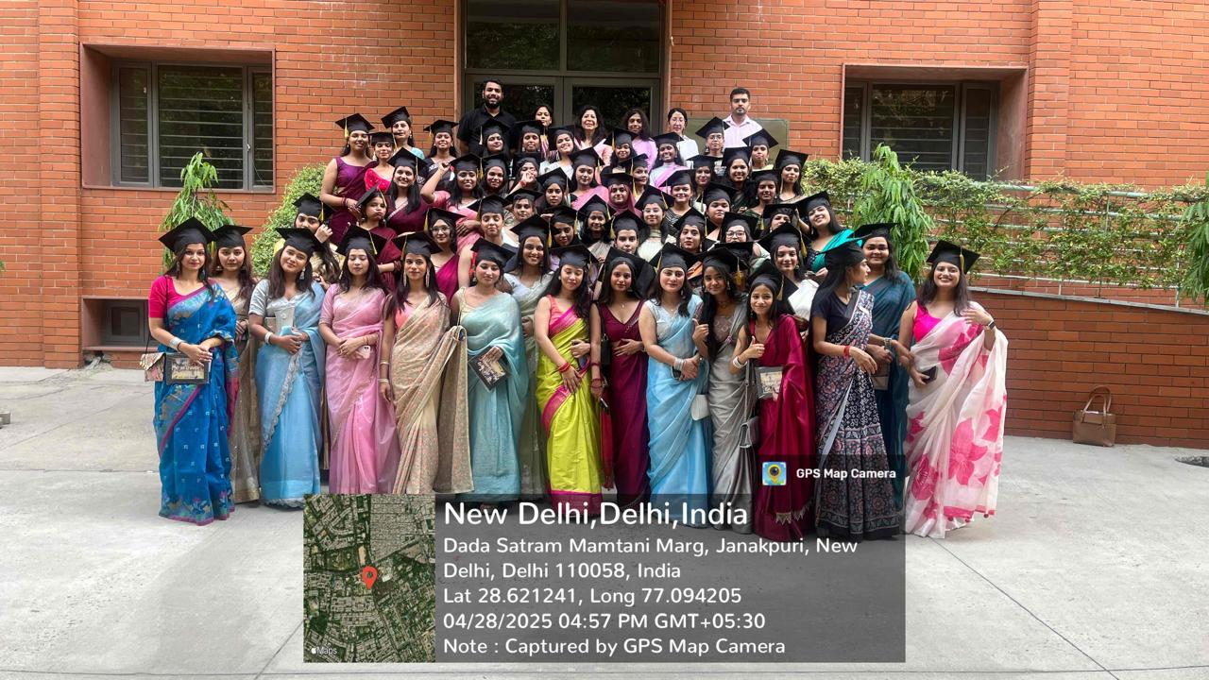
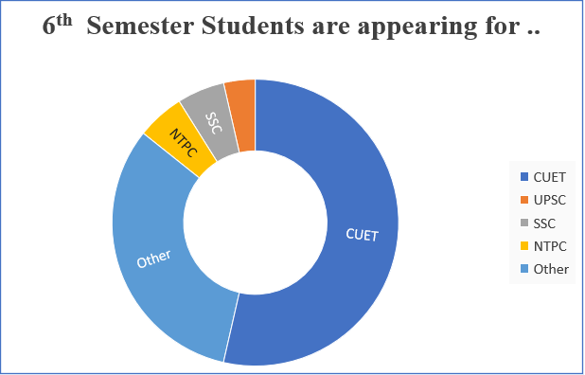
Student Progression
Documentary Proff.. Available at - https://docs.google.com/forms/d/1E5zs8Xo2Iamzg5aNZkevxrRb50527yybGxCXvBvCYnE/edit#responses

Slide 21

Activities Organized By the Department of Political Science
Date | Nature | Title | No. of Students
26/11/2024 | Roundtable Conference | One Nation, One Election | 61
14/11/2024 | Debate Competition | Role of Media and Democracy | 60
21/10/2024 | Investiture Ceremony | Student Union | 134
28.2.2024 | Parliament Visit | Constitution :A Living Document | 19
26.3.2024 | Quiz and Essay Competition | Quiz and Essay | 86
25.2.2024 | Strategic Board Game | Kursi | 104
13.2.2024 | Talk: Dr Richa Kumar | AI: Pain or Panacea | 109

Slide 22
Contd……

Slide 23
Alumni Data
Bhawna Kapoor
Batch- 2011-2014
Presently working as CEO of a PR firm, Aurafllow
Komal
Batch- 2011-14
Assistant Prof. Shyama prasad Mukherjee college
Nandita
Batch- 2011-14
Assistant Prof.
Shyam Lal college, DU
Ms. Khushboo
B.A. Political Science(H)
2017-2020
Qualified UGC NET
Ms. Shalini Singh
B.A. Political Science(H)
2017-2020
Qualified UGC NET
Adhya Shakti Mishra
Batch- 2021-2024
Pursuing M.A Pol Sc. from SOL,DU .
Swati Mishra
Batch: 2021-24
Pursuing MA in Political Science from DU SOL
Nandini Garg
Batch- 2021-2024
Pursuing M.A. Pol Sc. from IGNOU
Alphons Roy
Batch - 2021- 2024
MA public Administration And policy Studies, central University Of Kerala
Anisha kumari
Batch 2021–2024
Pursuing M.A. Political Science (DU, SOL)
Mamta
Batch 2021-24
M. A. Pol. Sci. (IGNOU) (pursuing)
Shweta Singh
Batch 2021-24
Pursuing M.A. Political Science (DU, SOL)

Slide 24

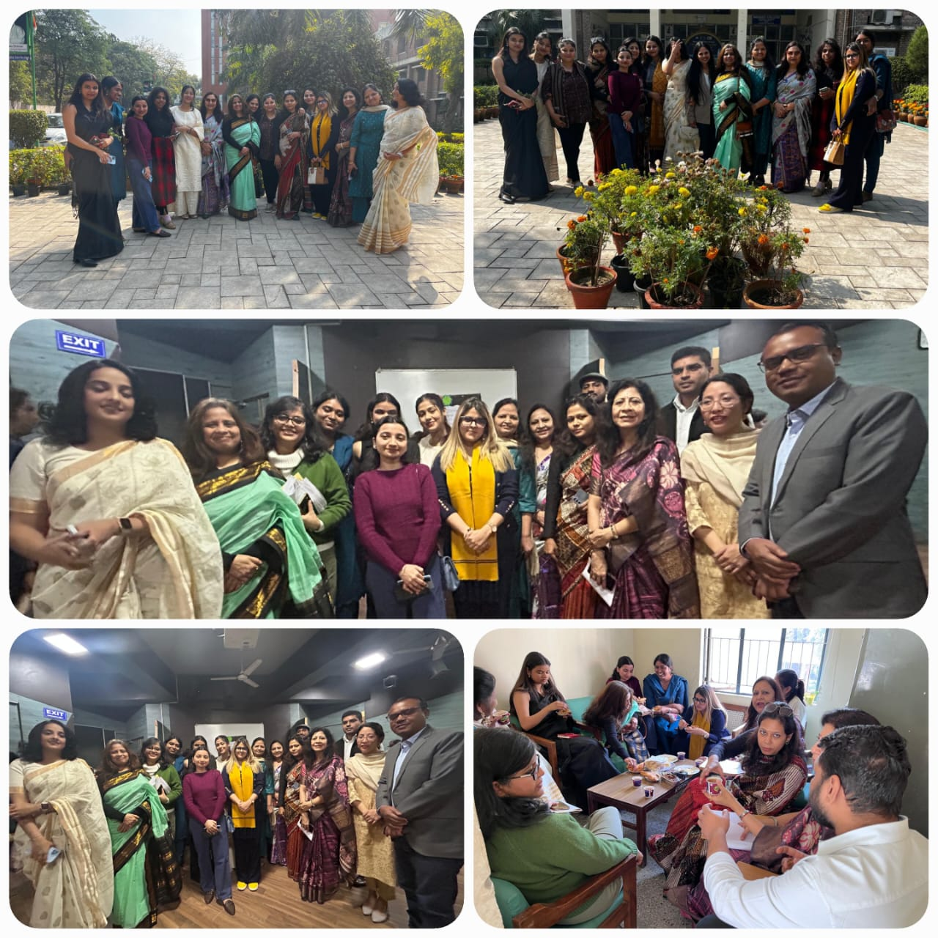
Rubal Sansanwal
Batch- 2020-2023
Pursuing MA in Political Science, Maitreyi College, University of Delhi
Payal
Batch- 2021-2024
Pursuing M.A Pol Sc. from IGNOU
Sai Archana
Batch 2021-24
PG Diploma In Journalism(English) from the Indian Institute Of Mass Communication
Reporting Intern at The Hindu

Slide 25
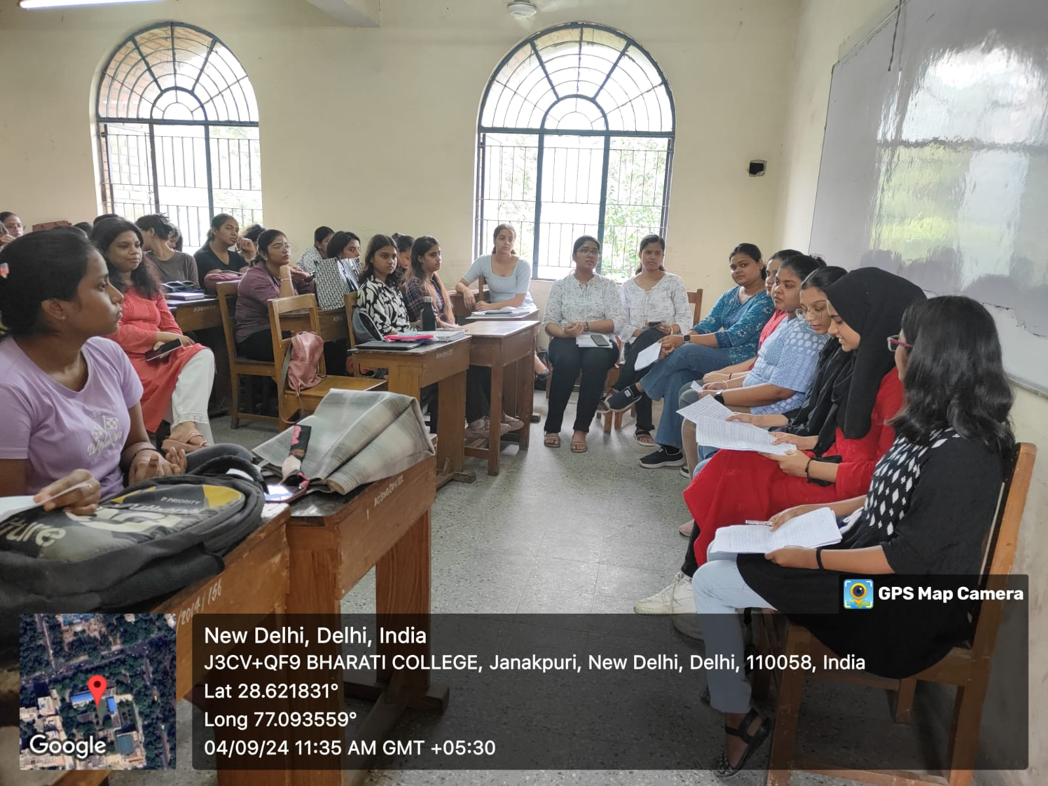
Best Practices of The Department
Department Organized National Seminar in 2024-25 and MUN in 2023-24
Students visited the Parliament of India
Department hosts the IR group under the Lakshaya Society.
Inter-Section Round Table discussion
Research-oriented innovative Assignments in the class.
Peer learning during our Tutorial class.
Students carried out the case study of trends in the Delhi Election 2025.
Organizes talks on the relevant issues.
Continuous Mentorship to students for appearing UPSC/PCS or other competitive exams.
Continuous Election of the members of the Departmental society.

Slide 26
Progress Report
Suggestions given in previous Audit dated 22nd April 2024 | Measures Taken By Department
1. Effective use of tutorials and innovation in teaching pedagogy needed. | The department has motivated students for Inter-Section Group Discussion Case Studies on Different Political Phenomena Students are encouraged for Research- Oriented Assignments/Projects Peer Learning as per NEP 2020
2. Enhance Student Progression and academic preparation for competitive exams such as UPSC. | The department started a continuous mentoring session - This year, two ongoing students are appearing for UPSC, and three students are appearing for SSC and NTPC. Meanwhile, thirty-five students have appeared for CUET - 2025.

Slide 27
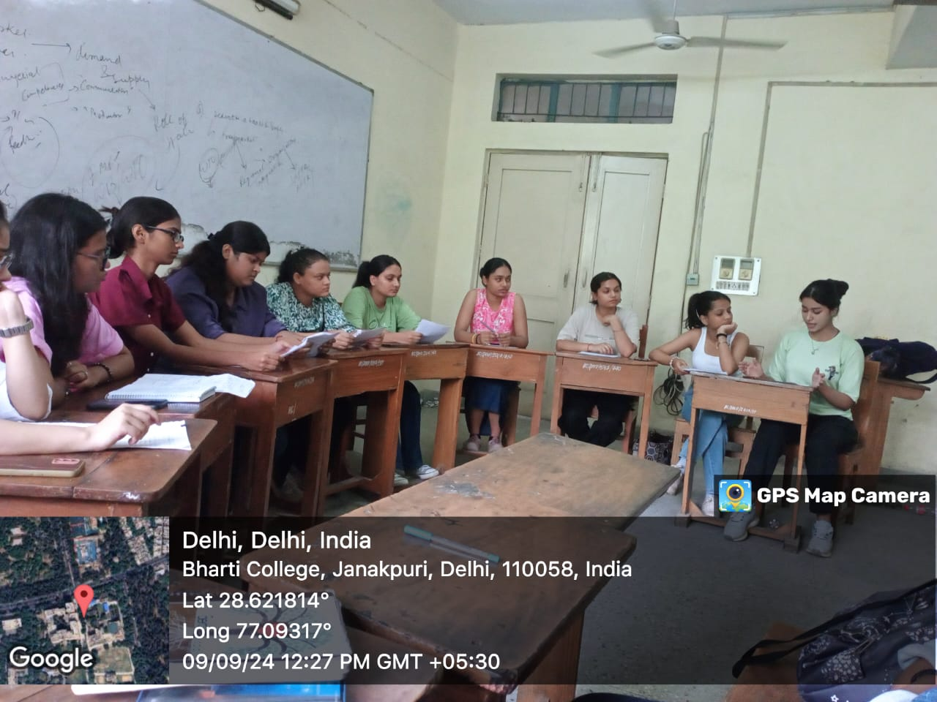
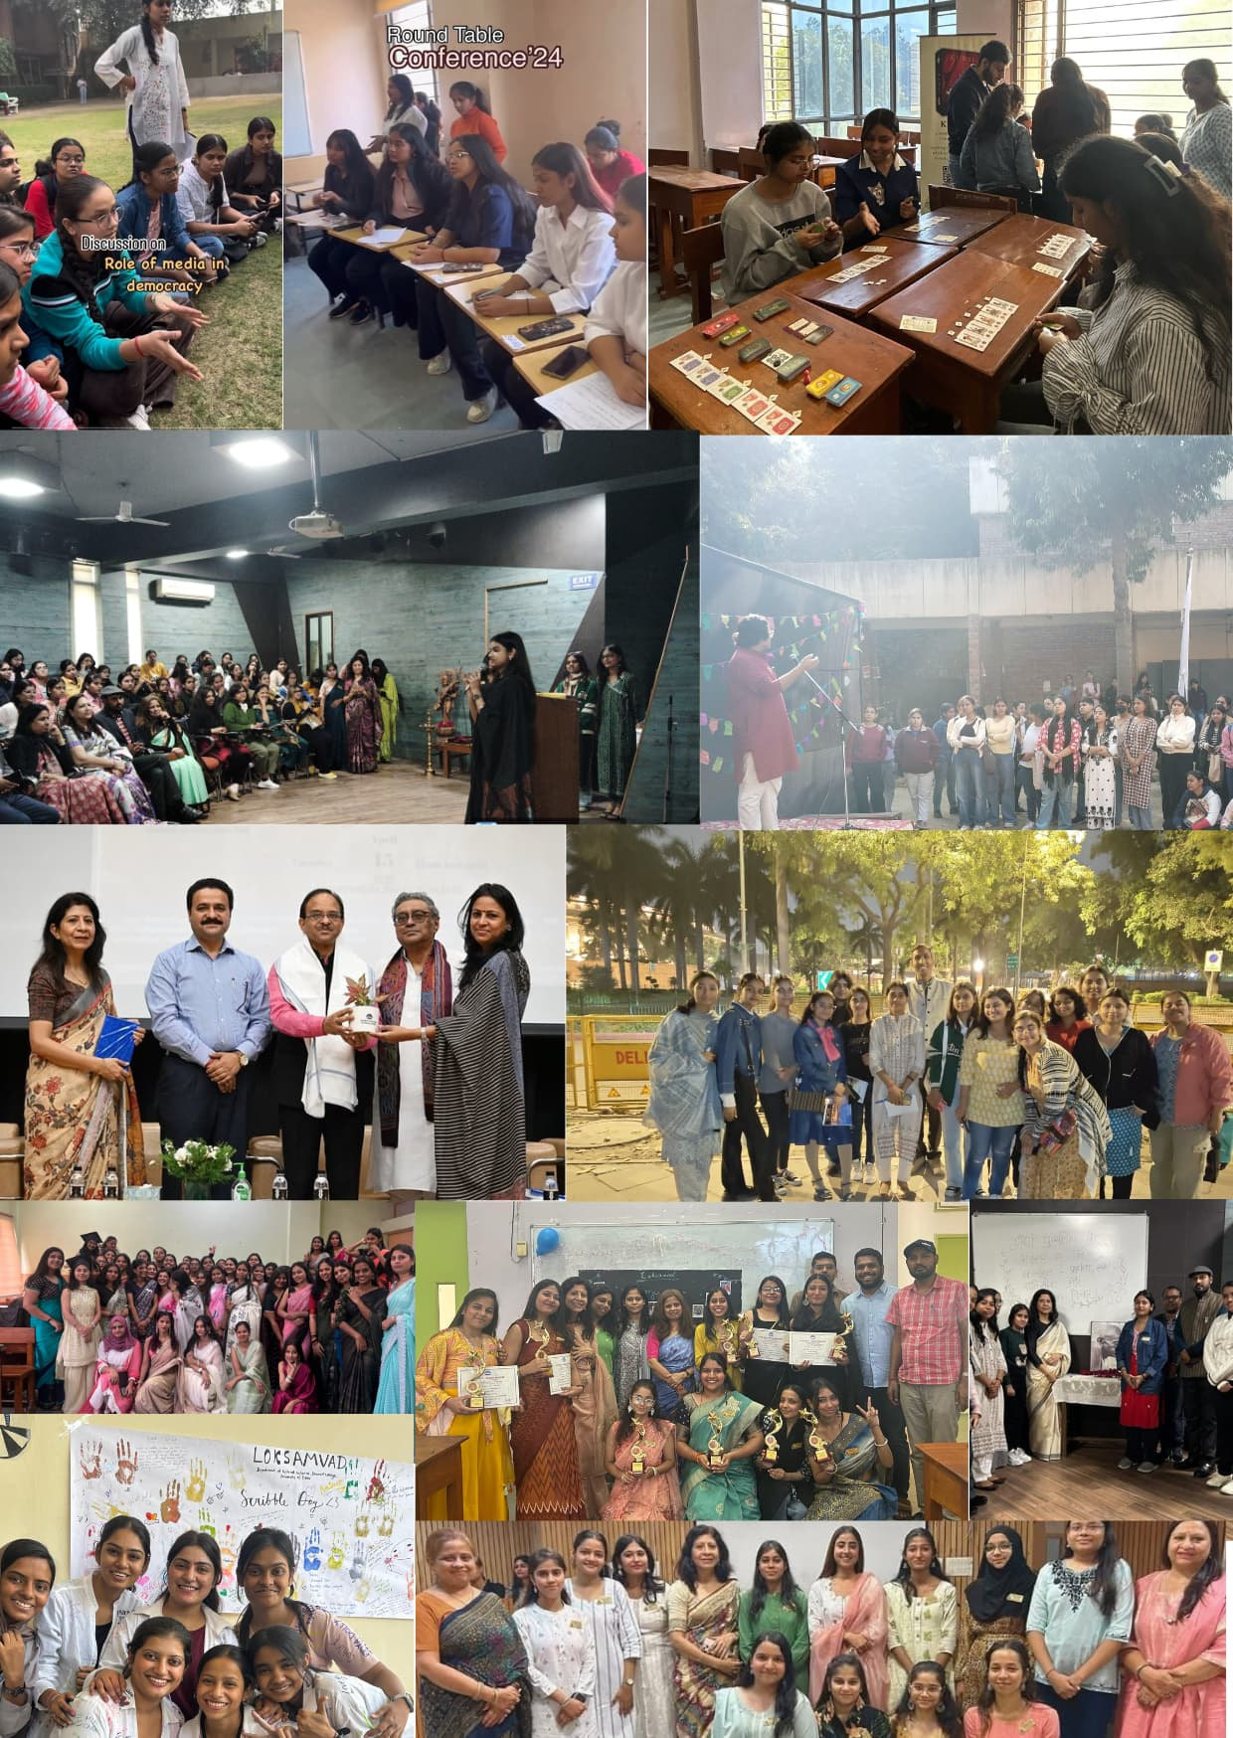
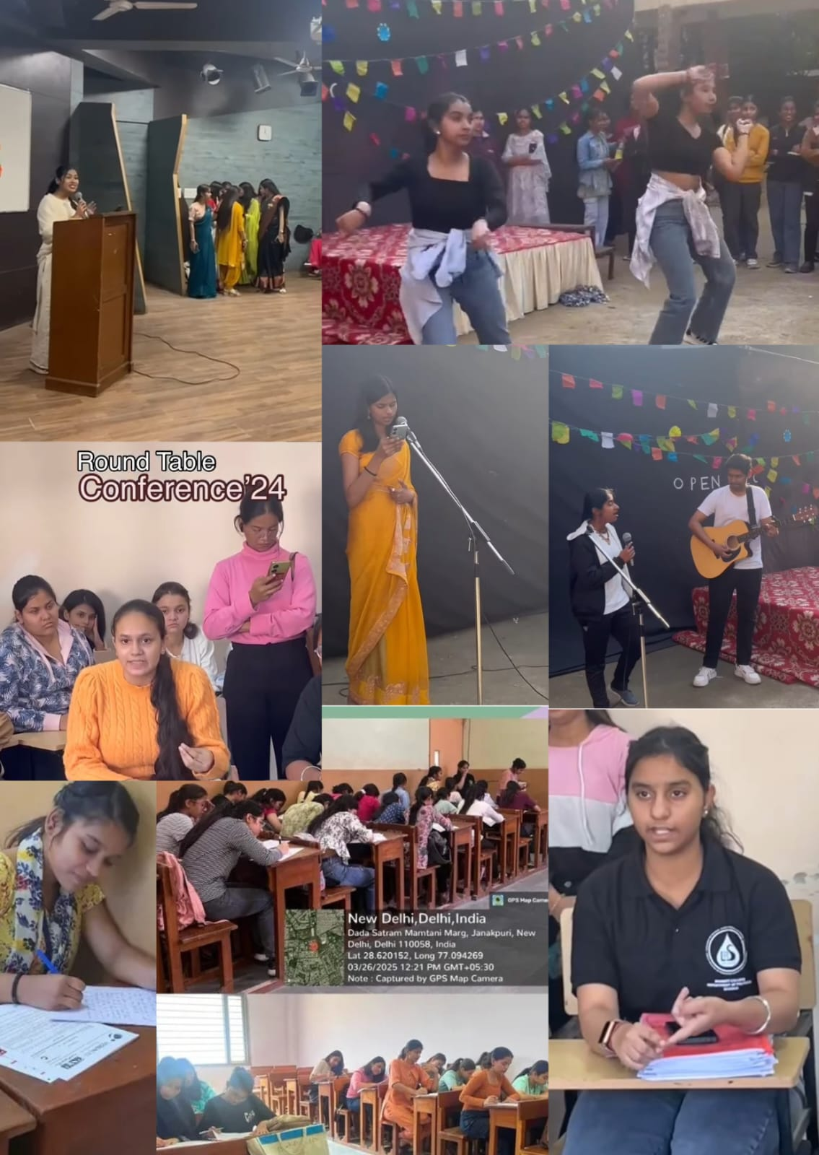
Photo Gallery

